Slide 1
Security & cryptography final project
Barna tudor-cristian

Slide 2
Algorithms
Symmetric key:
DES – fixed key size (64-bit key, only 56 are used)
Blowfish – variable length key (32–448-bit)
Both are variations of Feistel Cipher
Asymmetric key:
RSA – not implemented

Slide 3
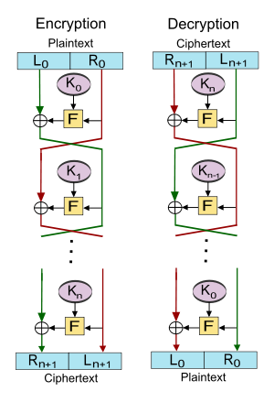
Feistel Cipher
Generate the Round Keys (Key Schedule)
Split input in halves
Apply a Round Function: F(One Half, Round Key)
XOR the output with the other half
Repeat for N rounds
To decrypt, reverse the order of the Round Keys

Slide 4
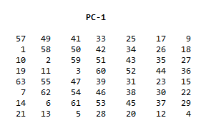
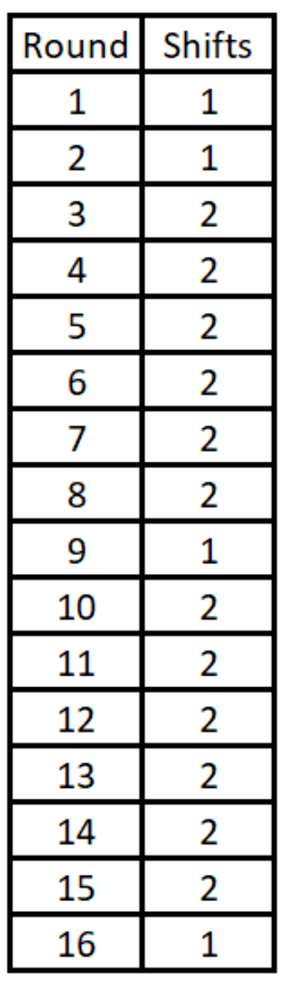
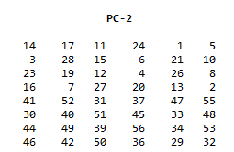
DES Steps – Key schedule
64-bit key input;
Permute key’s bits according to PC-1 -> 56 bits
The 57th bit of the key becomes the first bit, the 49th is the 2nd, and so on.
The 8 remaining bits were intended to be used as parity bits.
Split in half -> 2 28-bit halves, C & D
Left shift and store C & D 16 times, by 1 or 2 bits, based on schedule
Finally, each round’s C_{n}D_{n} pair is concatenated, and shifted according to PC-2 -> 48-bit round key K_{n}

Slide 5
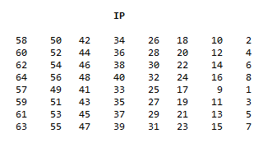
DES STEPS – Splitting and Rounds
Before splitting, permute the block according to Initial Permutation IP
Block’s 58th bit becomes the first bit, 50th -> 2nd, etc
Split in halves -> L₀ and R₀, 32-bits each.
For 16 rounds do
L_{n} = R_{n-1}
R_{n} = L_{n-1} XOR f(R_{n-1}, K_{n})
Notice the Swaps between the Left and Right halves, every round

Slide 6
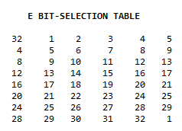
DES STEPS – Round function
First, expand the 32-bit R_{n-1} according to the table -> 48-bit E(R)
32nd bit becomes the first, 1st becomes the 2nd, etc.
XOR E(R) with the Round Key. -> 48-bit,
8 groups of 6 bits -> B₁, B₂, … B₈
These groups of 6 bits are used to shrink the 48-bit result back to a 32-bit value

Slide 7
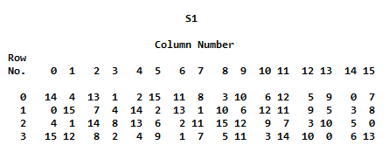
DES STEPS – Round function
Each of the 6-bit groups has a corresponding S-box
S₁, S₂, … S₈
6-bit values -> R₀ C₀C₁C₂C₃ R₁
R₀R₁ -> Binary values from 00-11 -> 0 to 3 Row index
Similarly, middle 4bits -> 0 to 15 Column index
The output is the binary representation of the number indicated
S-box 1

Slide 8
DES STEPS – Round function
Example
Input: B₁ = (011011)
Row -> 01 binary -> 1 decimal
Column -> 1011 binary -> 11 decimal
S₁ Row 1 Col 11 -> 11
S₁(B₁) = Binary(11) = 1011
Repeat for all 8 6-bit groups and concatenate the results.
S-box 1

Slide 9
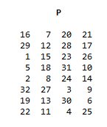
DES STEPS – Round function
The concatenated result is one last time permuted according to table P
This is the final output of the Round Function

Slide 10
BLOWFISH – Sub-keys
For blowfish, there are 18 32-bit subkeys (the P-array) and 4 32-bit S-boxes with 256 values each S_{1, 0}, S_{1, 1}…S_{1, 255}; S_{2, 0}, S_{2, 1}…S_{2, 255}; S_{3, 0}, S_{3, 1}…S_{3, 255}; S_{4, 0}, S_{4, 1}…S_{4, 255};
Before any encryption/decryption, these must be initialized and put through the Blowfish algorithm by themselves.

Slide 11
BLOWFISH – Sub-keys
Initialization:
First the P-array, then the S-boxes.
Initialized with the hex representation of decimals of Pi, without the 3.
P1 = 0x243f6a88; P 2 = 0x85a308d3; P3 = 0x13198a2e; P4 = 0x03707344, etc.
Then, XOR P1 with the first 32 bits of the key, P2 with the 2nd 32 bits and so on, until the entire P-array has been XOR’ed.
Repeat the key as many times as necessary: A -> AA -> AAA.

Slide 12
BLOWFISH – further pre-work
With these sub-keys, encrypt the all-zero block and replace P1 and P2 with the result
Encrypt that result and replace P3 and P4.
Repeat until all P-array entries, and all S-box entries, in order, have been replaced.

Slide 13
BLOWFISH – further pre-work
In Pseudo-code:
init = 0 for i = 1 to 17, step 2 init = encrypt(init) P[i] = init >> 32 P[i+1] = init & 0xFFFFFFFF for i = 1 to 4 for j = 1 to 255, step 2 init = encrypt(init) S-box[i][j] = init >> 32 S-box[i][j+1] = init & 0xFFFFFFFF

Slide 14
Blowfish – Handling a block
Divide the block into 32-bit halves, L and R
for i = 1 to 16 L = L XOR P[i] R = F(L) XOR R Swap(L,R) Swap(L,R) //Undoing the last swap R = R XOR P[17] L = L XOR P[18] output = L << 32 | R // Combine the halves.
Decryption follows the same steps, just reversing the order of the P-array.

Slide 15
Blowfish – Round function
Divide L into 4 quarters, 8 bit each : a, b, c, d
F(L) = ((((S_{1, a} + S_{2, b} )mod 2³²) XOR S_{3, c}) + S_{4, d} )mod 2³²

Slide 16
However…
What if the file length is not an exact multiple of blocks
e.g. 5 blocks and 48 bits.
That’s where padding schemes come into play.

Slide 17
padding
Simply put, a padding scheme describes how you “fill the gap” in the last block of the file
When encrypting the example, you fill the last 2 bytes
When decrypting, you must omit the last 2 bytes.
There are multiple types of padding that are used
E.G. PKCS5, OneAndZeroes
Naturally, the encryption and decryption programs should follow the same scheme

Slide 18
Chosen padding – PKCS5
Take the number of bytes your last block is -> n
Subtract it from what it should be -> B-n = p
Pad all remaining bytes with that number
Examples:
4 bytes: FFFFFFFF________-> FFFF04040404
7 bytes: FFFFFFFFFFFFFF__ -> FFFFFFFFFFFFFF01
Edge case: padding an exact multiple of blocks adds a new block.
8 bytes: FFFFFFFFFFFFFFFF -> FFFFFFFFFFFFFFFF 0808080808080808

Slide 19
Chosen padding – PKCS5
When decrypting:
Look at the last byte
Omit that number of bytes from the end.
Note: not implemented in time.

Slide 20
Resources used
DES:
FIPS 46-3
J. Orlin Grabbe - The DES Algorithm Illustrated
Blowfish:
Schneier, B. (1994). Description of a new variable-length key, 64-bit block cipher (Blowfish). In: Anderson, R. (eds) Fast Software Encryption. FSE 1993. Lecture Notes in Computer Science, vol 809. Springer, Berlin, Heidelberg. https://doi.org/10.1007/3-540-58108-1_24
List of constants for use in Blowfish : https://www.schneier.com/wp-content/uploads/2015/12/constants-2.txt
RSA:

